Slide 1
Multiprocessor Configurations
Flynn’s classification,
Parallel processing concepts,
Introduction to pipeline processing and pipeline hazards,
design issues of pipeline architecture,
Instruction pipelining

Slide 2
Parallel Processing Concepts
Executing multiple tasks concurrently to fulfil increasing demands for higher performance
Need to process data concurrently to achieve better throughput
capable of concurrent data processing to achieve faster execution times.
Parallelism
Multiple functional units-several ALU’s
Multiple processors-several processors operating concurrently

Slide 3
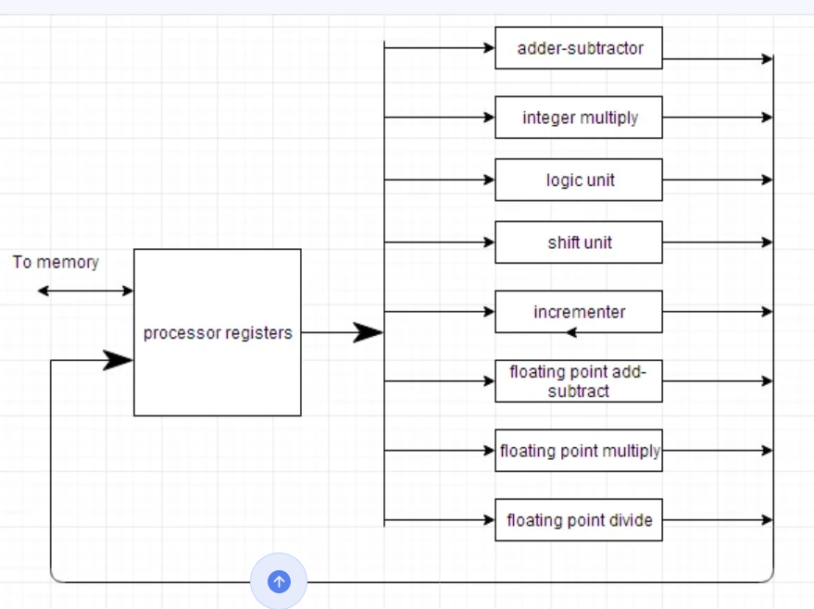
All these units will work concurrently and produce the required output.

Slide 4
Flynn’s Classification-Types of Parallel Processor Systems
Based on
Internal organization of processors
Interconnection Structures Instruction Stream
Instruction from main memory to processor
Data Stream
Operands flowing to and fro from the processor

Slide 5
FLYNN’s CLASSIFICATION
Multiple Processor Organization
Single instruction, single data stream - SISD
Single instruction, multiple data stream - SIMD
Multiple instruction, single data stream - MISD
Multiple instruction, multiple data stream- MIMD

Slide 6
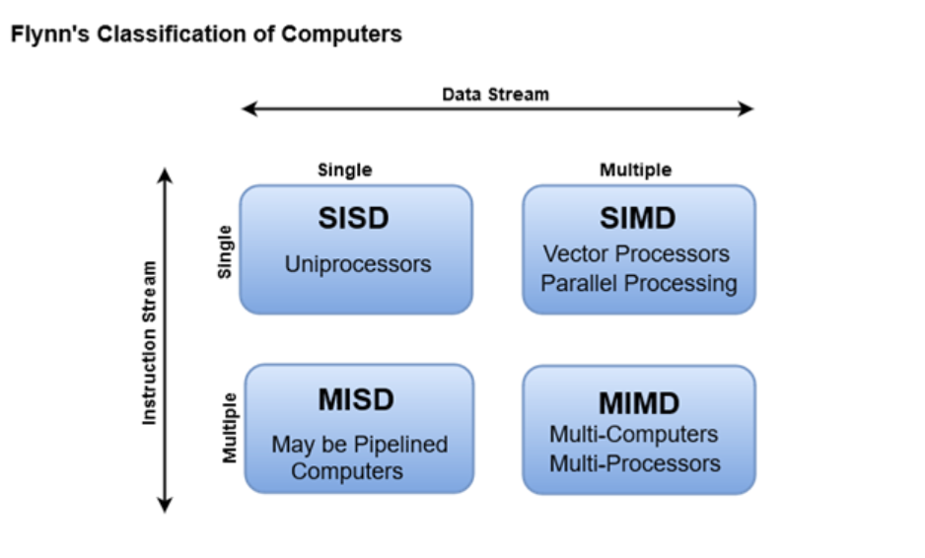

Slide 7
Single Instruction, Single Data Stream - SISD
A single processor executes a single instruction stream to operate on data stored in a single memory
Uni-processor
Each "PU" (processing unit) does not necessarily correspond to a processor, just some functional unit that can perform processing.
The PU's are indicated as such to show relationship between instructions, data, and the processing of the data.

Slide 8
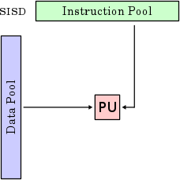

Slide 9
Single Instruction, Multiple Data Stream - SIMD
A single machine instruction controls the simultaneous execution of a number of processing elements
Each processing element has an associated data memory, so that each instruction is executed on a different set of data by the different processors.
Vector and array processors

Slide 10
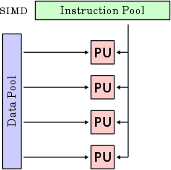

Slide 11
Multiple Instruction, Single Data Stream - MISD
A sequence of data is transmitted to a set of processors, each of which executes a different instruction sequence.
Each processing unit operates on the data independently via separate instruction stream.
This structure is not commercially implemented.

Slide 12
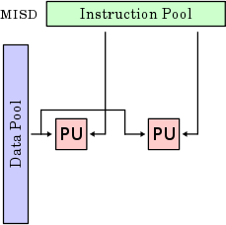

Slide 13
Multiple Instruction, Multiple Data Stream- MIMD
Set of processors
Simultaneously execute different instruction sequences on different sets of data
SMPs, NUMA systems
SMP-Symmetric multiprocessing--multiple identical processors are interconnected to a single shared main memory,
Non-Uniform Memory Access-configuring a cluster of microprocessors in a multiprocessing system so they can share memory locally.

Slide 14
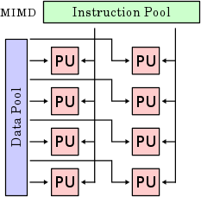

Slide 15
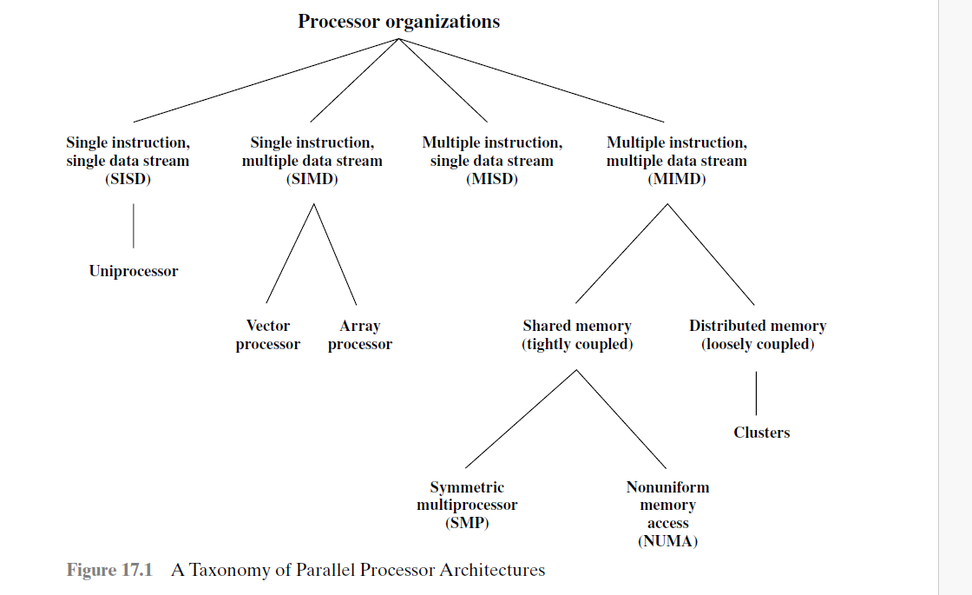

Slide 16
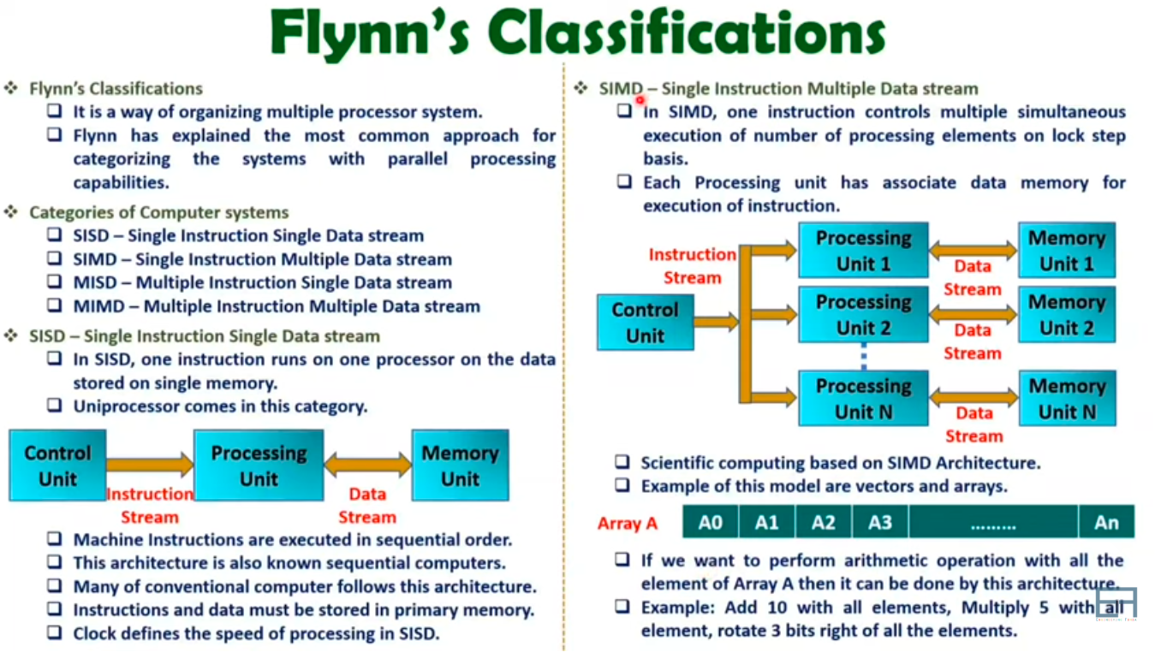

Slide 17
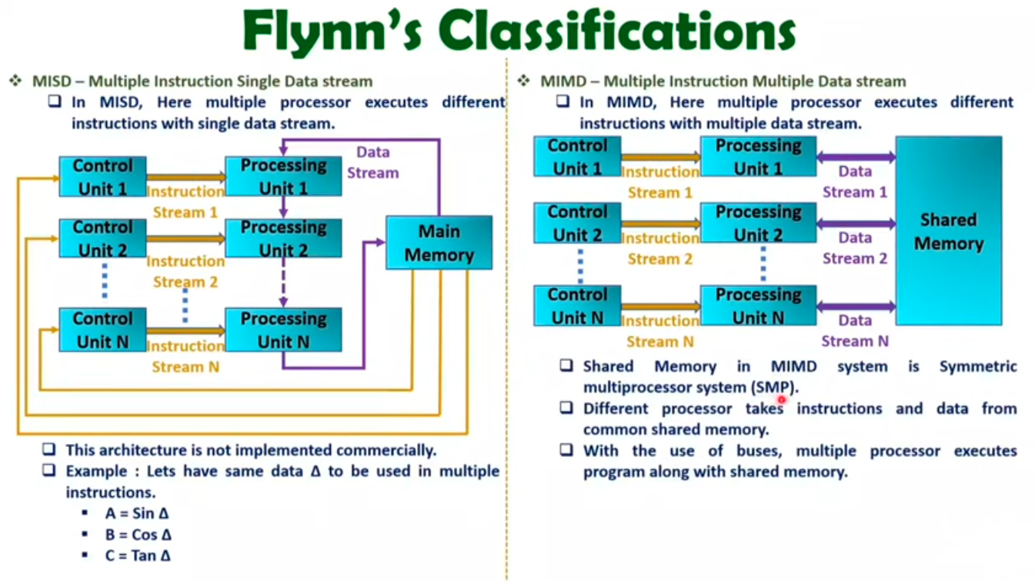

Slide 18
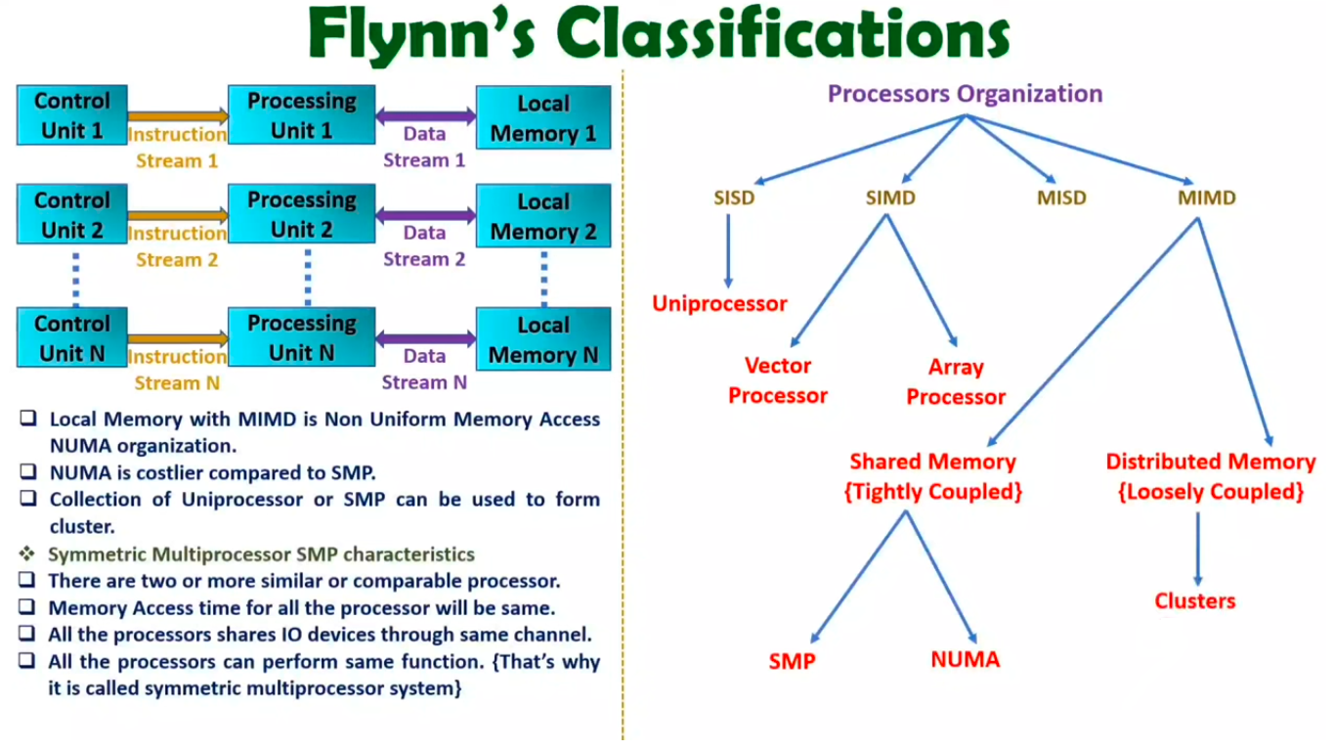

Slide 19
Introduction to pipeline processing and pipeline hazards
Pipelining- Temporal overlapping of processing
Subdivide input task(process) into a sequence of subtasks
Each executed by specialized hardware that operates concurrently with other stages of pipeline
Improvement of system throughput
In Pipelining, specialized hardware stages are also known as hardware segments,.

Slide 20
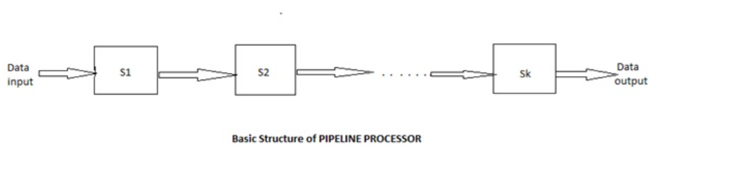
linearly connected to perform a fixed function over a stream of data flowing from one end to the other
A processor supporting such a hardware architecture computation is known as pipeline processor.
Pipeline processors are constructed with k processing stages. Data inputs such as operands are fed into the pipeline at the first stage S1. The processed results are passed from stage Si to stage Si+1, for all i = 1, 2, 3… k-1

Slide 21
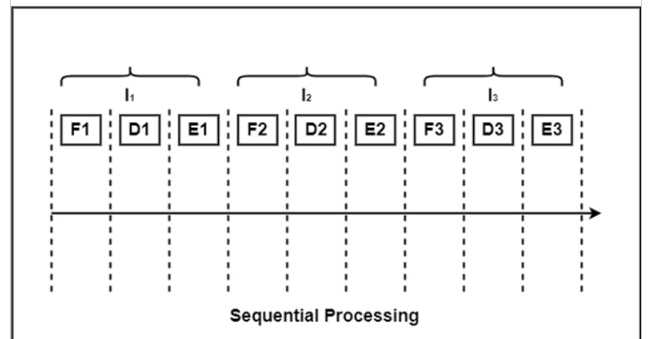
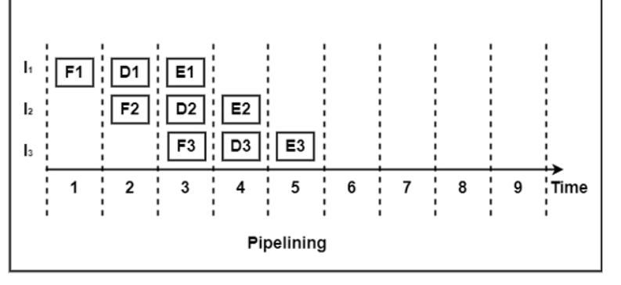

Slide 22
Pipelining allows the next instructions to be fetched while the processor is performing arithmetic operations
Holds them in a buffer close to the processor until each instruction operation can be performed.
The staging of instruction fetching is continuous.
Each task is subdivided into multiple successive subtasks.
A pipeline phase is defined for each subtask to execute its operations.
The process continues until the processor has executed all the instructions and all subtasks are completed.
https://www.techtarget.com/whatis/definition/pipelining#:~:text=With%20pipelining%2C%20the%20next%20instructions,for%20each%20instruction%20is%20performed.
Merits & demerits

Slide 23
There are two types of pipelining:
Arithmetic pipelining
Instruction pipelining
Arithmetic pipelining- The integer arithmetic and floating point arithmetic) are performed by two separate units to introduce parallelism. These units perform scalar operations involving one pair of operands at a time.
Instruction pipelining- sub cycles of instruction are performed simultaneously to reduce overall processing time-instruction pipelining.

Slide 24
As the instruction process is divided into four stages so it is also known as Four Stage Instruction Pipeline.
Fetch: read the instruction from the memory.
Decode: decode the opcode and fetch source operand if necessary.
Execute: Perform the operation specified by the instruction.
Store: store the result in the destination.
four distinct hardware units are needed- capable of performing their tasks simultaneously and without interfering with one another. Information from one stage is passed to the next stage with the help of the buffers.

Slide 25
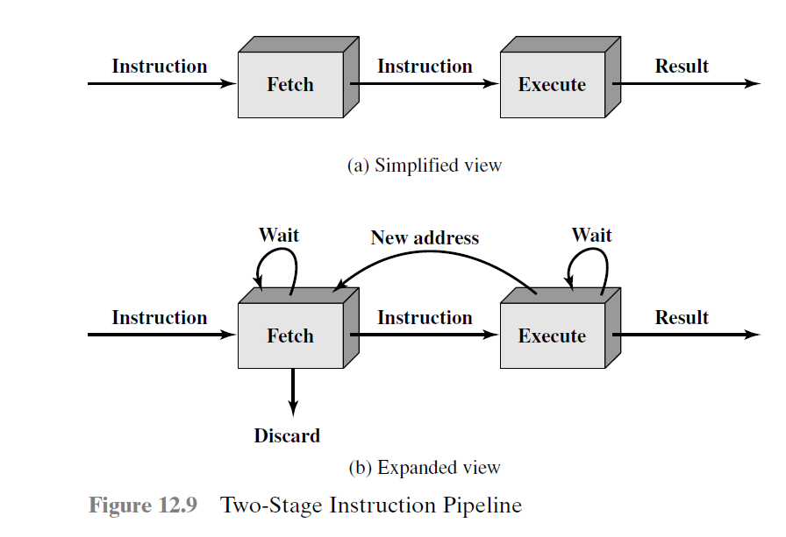
INSTRUCTION PIPELINING
New inputs are accepted at one end before previously accepted inputs appear as outputs at the other end.
The first stage fetches an instruction and buffers it.
When the second stage is free, the first stage passes it the buffered instruction.
While the second stage is executing the instruction, the first stage takes advantage of any unused memory cycles to fetch and buffer the next instruction- Instruction prefetch or fetch overlap

Slide 26
This requires more registers to store data between stages
If the fetch and execute stages were of equal duration, the instruction cycle time would be halved.
Doubling of execution rate is due to
Execution will involve reading and storing operands and the performance of some operation (waiting for fetch stage-more time for execution)
A conditional branch instruction makes the address of the next instruction to be fetched unknown
To gain further speedup, the pipeline must have more stages

Slide 27
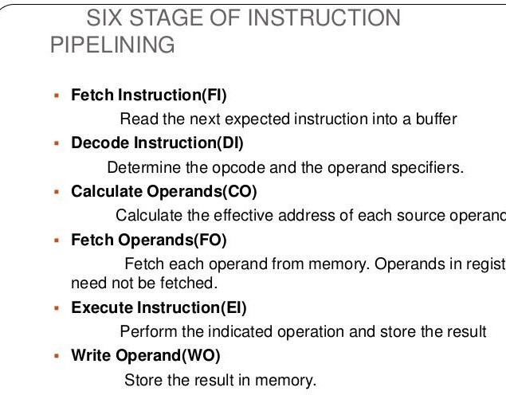

Slide 28
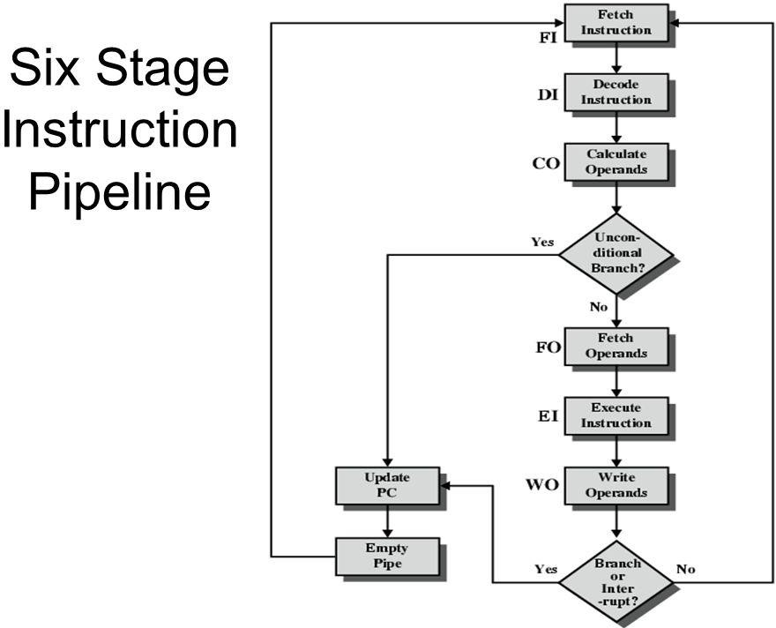

Slide 29
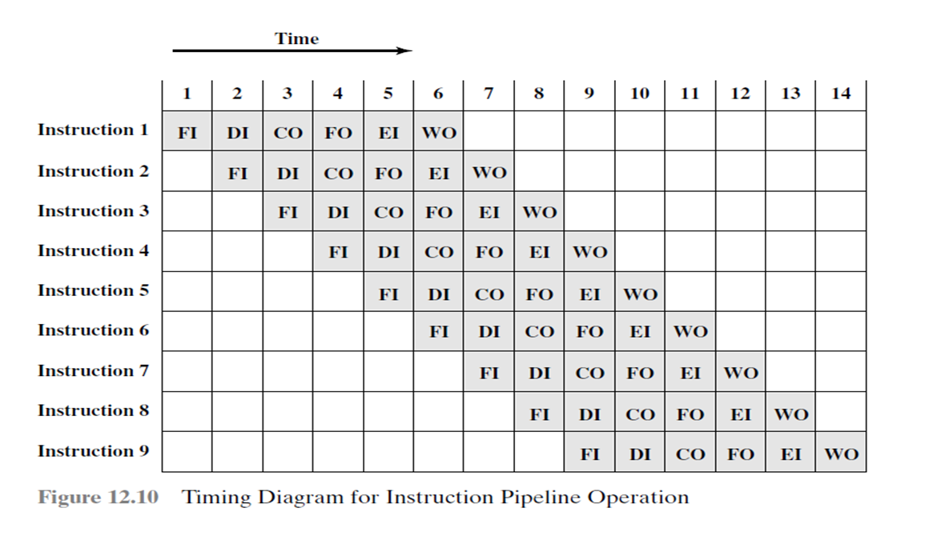
Timing diagram for 6 stage instruction pipeline

Slide 30
six-stage pipeline can reduce the execution time for 9 instructions from 54 time units to 14 time units.
the timing is set up assuming that each instruction requires all six stages (a load instruction does not need the WO stage)
Also, the diagram assumes that all of the stages can be performed in parallel
Assumes no memory conflicts-memory access can occur simultaneously
Fig 12.11-Conditional branch in Instruction pipelining

Slide 31
Pipeline hazards
Any reason that causes the pipeline to stall is called hazard or conflict
A pipeline hazard occurs when the pipeline, or some portion of the pipeline, must stall because conditions do not permit continued execution-pipeline bubble.
Resource usage
( inter instruction dependencies)
Job scheduling problems (where different tasks get executed at pre-determined time or when the right event happens.)

Slide 32
3 types of Hazards
RESOURCE CONFLICTS
insufficient resources
DATA or DATA DEPENDENCY CONFLICTS
instruction in pipeline depend on result of previous instruction which still in pipeline yet to be completed
BRANCH DIFFICULTIES-Contents of PC get changed

Slide 33
RESOURCE HAZARD
when two (or more) instructions that are already in the pipeline need the same resource.
executed in serial rather than parallel
Stalling pipeline causes Structural Hazard
Commonly need Memory Access
– Use separate cache for instruction and data

Slide 34
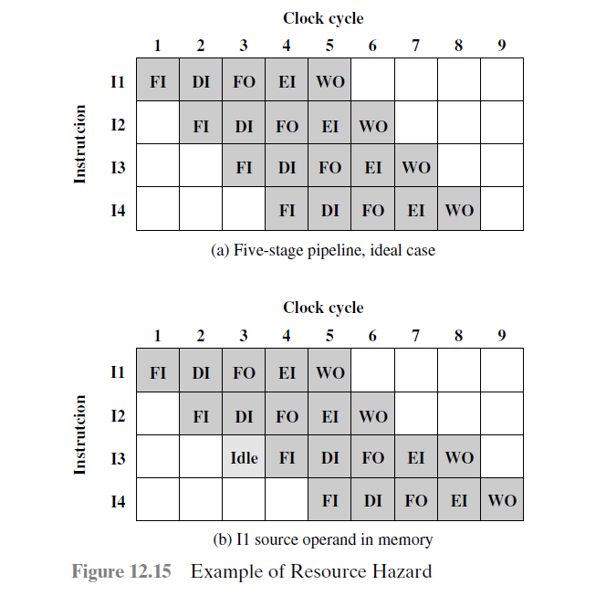
Resource conflict
Fig a-each stage takes one clock cycle.
Fig b- main memory has a single port and that all instruction fetches and data reads and writes must be performed one at a time
the fetch instruction stage of the pipeline must idle for one cycle before beginning the instruction fetch for instruction I3

Slide 35
Resource conflict
multiple instructions are ready to enter the execute instruction phase and there is a single ALU.
Solution- increase available resources, such as having multiple ports into main memory and multiple ALU units.
DATA HAZARD
when there is a conflict in the access of an operand location.
the program produces an incorrect result because of the use of pipelining-

Slide 36
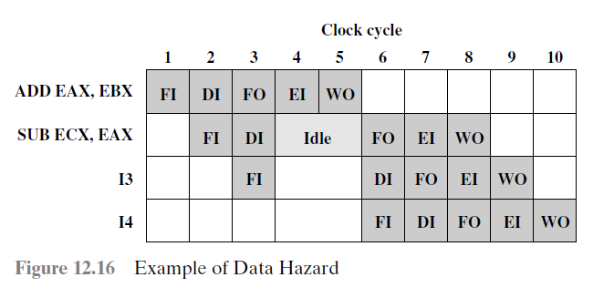
ADD EAX, EBX /* EAX = EAX + EBX
SUB ECX, EAX /* ECX = ECX - EAX
The ADD instruction does not update register EAX until the end of stage 5, which occurs at clock cycle 5.
But the SUB instruction needs that value at the beginning of its stage 2, which occurs at clock cycle 4.
To maintain correct operation, the pipeline must stall for two clocks cycles.

Slide 37
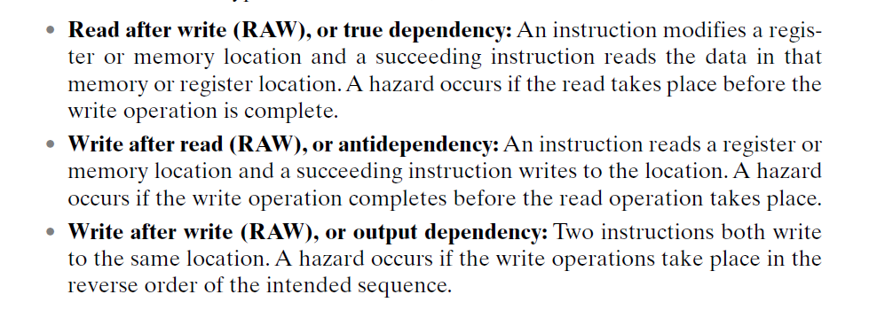
DATA HAZARD
RAR?
Rearrange the pipeline- pipeline scheduling

Slide 38
BRANCH HAZARDS
Flush Pipeline
Delayed branching
Conditional branching
Branch hazards are caused by branch instructions and are known as control hazards in computer architecture. The flow of program/instruction execution is controlled by branch instructions. Remember that conditional statements are used in higher-level languages for iterative loops and condition testing (correlate with while, for, and if case statements). These are converted into one of the BRANCH instruction variations. As a result, when the decision to execute one instruction is reliant on the result of another instruction, such as a conditional branch, which examines the condition’s consequent value, a conditional hazard develops.

Slide 39
Design issues of pipeline architecture
Instruction Pipeline design
Instruction Issuing
In order issuing, out of order issuing or re order issuing
Arithmetic Pipeline design
Fixed point , floating point , integer arithmetic

Slide 40
Principles of designing pipelined processors
Proper data buffering (Preloading data into a reserved area of memory) to avoid congestion and smooth pipeline operations
Instruction dependence relationship
Logic hazards should be detected and resolved
Avoid Collisions and structural hazards by proper
sequencing
Reconfiguration of the pipeline should be possible

